Slide 1



University
of
Toledo
www.gracescorner.me
Optimizing
LinkedIn
Ace Kim

Slide 2
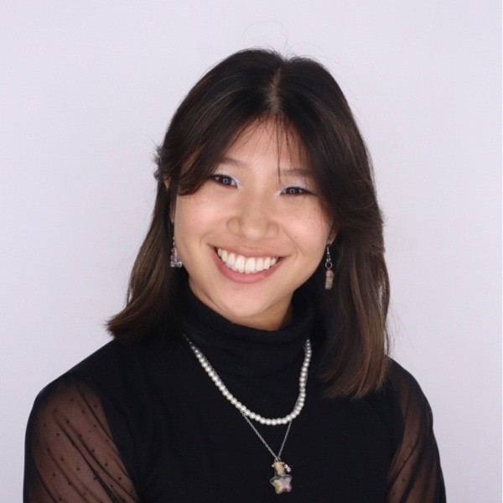
Grace Kim
  IS & Marketing dual major at UToledo | Spring ‘25
  Talent acquisition and social media professional experience
  President of AMA / 2023-24 Outstanding Chapter Award
  Collegiate Vice President on National Council of PSE
  6 internships during last 3.5 years of undergrad
  Personal career mentor in-person and virtually

Slide 3
Building an Effective Profile
  Profile Photo – should be high quality with a neutral background, just you.
  Your LinkedIn Headline – professional brand and differentiation.
  Introduce yourself in the first person in your profile summary
  Show impact and results with media posts showcasing your experience and using key words.
  Pick 3 to 5 of your top skills to showcase and ask for endorsements this improves searchability by 27%.

Slide 4
But what is my personal brand?
  Who are you? (Self-reflection)
  How do you want to brand yourself / be remembered?
  People don't remember what you do, but how you make them feel
  Personality tests:
    Meyers Brigg, DISC Assessment, Insights Colors, PI Assessment, Enneagram, EI test
  Meditation, journaling, therapy, asking friends and family.
About Me
Building an Effective LinkedIn Profile
Personal Brand
Job Seeker Ettiquette
Following up
What to Post
Common Mistakes
LinkedIn Walkthrough

Slide 5
Job Seeker Ettiquette
  Quality connections with purpose - quality over quantity.
  Personalized invitations for connection requests.
  Professional communication- Please and Thank you, avoid personal matters and keep it clean.
  Privacy settings- adjust notifications on LinkedIn.
“Hi XXXX, I am currently exploring career opportunities in cybersecurity and came across your profile.
I am impressed by your accomplishments and would love to speak about your career path.
Would you have 15 minutes to chat on a call?”

Slide 6
Following Up on LinkedIn
  After applying for a job, follow-up with a brief message expressing your interest.
  Network follow-up, always send a thank you note within 24 hours of meeting the person, whether you meet them at an event or interview.
  When sending your note, try and include a detail from your conversation.
  Stay engaged with your emails and messages regularly.
  Thank-You notes are life-changing.

Slide 7
What To Post
  Anything professional related!!
  Student organizations, events, job fairs, networking sessions, volunteering, passion projects, job / internship updates, “OpenToWork”, awards, scholarships

Slide 8

Post Examples

Slide 9
Common Mistakes
  Being too personal on LinkedIn
  Hyperbolic messages
  Not using it (posting and updating job status)
  Not having a professional headshot
  Not having a personalized profile URL
  Poor headline / summary
  Contradictory information on profile and resume
  No skills, recommendations, endorsements

Slide 10
LinkedIn Walkthrough

Slide 11
Any Questions?

Slide 12
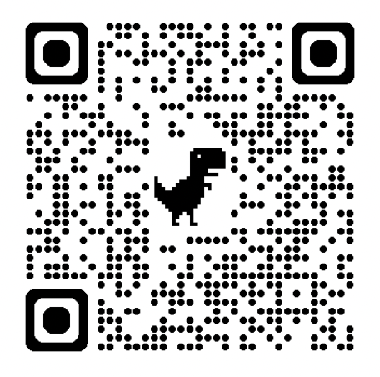
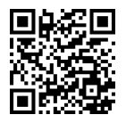


Giggling Platypus Co.
Contact Information
gracekim3002@gmail.com
https://www.linkedin.com/in/seyunkim03/

